Slide 1


PIZZAHUT_
SALES_
ANALYSIS_WITH SQL
By Er. Shiv Kumar Rana

Slide 2
OBJECTIVE:- To analyze pizzahut sales data using SQL to derive insights into
order patterns, revenue generation, and pizza preferences,
aiding in data-driven decision-making for improved business
outcomes.This concise statement encompasses the goals
outlined in the detailed points from this presentation.

Slide 3


1.Retrieve the total number of orders placed.

Slide 4
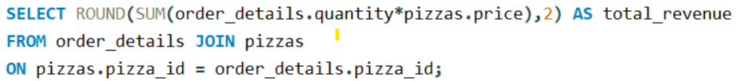

2.Calculate the total revenue generated from pizza sales.

Slide 5
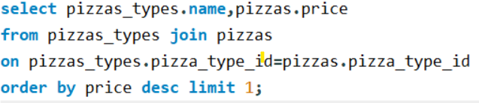

3.Calculate the total revenue generated from pizza sales.

Slide 6
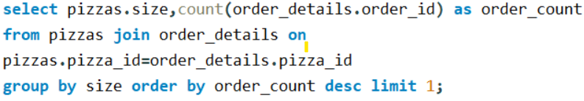

4.Identify the most common pizza size ordered.

Slide 7
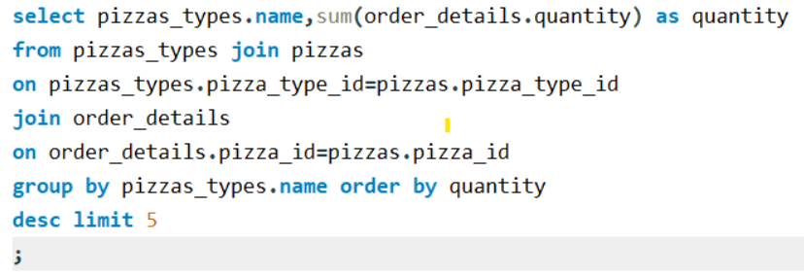
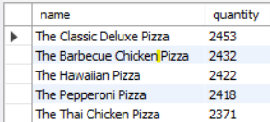
5.List the top 5 most ordered pizza types along with their
quantities.

Slide 8
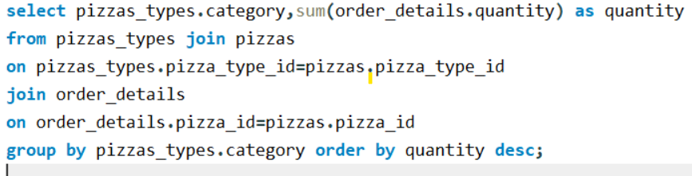
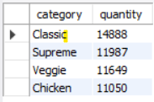
6.Join the necessary tables to find the total quantity of
each pizza category ordered.

Slide 9

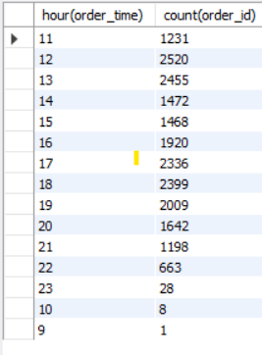
7.Determine the distribution of orders by hour of
the day.

Slide 10

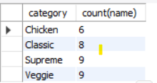
8.Join relevant tables to find the category-wise
Distribution of pizzas.

Slide 11
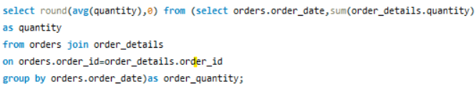

9.Group the orders by date and calculate the average number
of pizzas ordered per day.

Slide 12
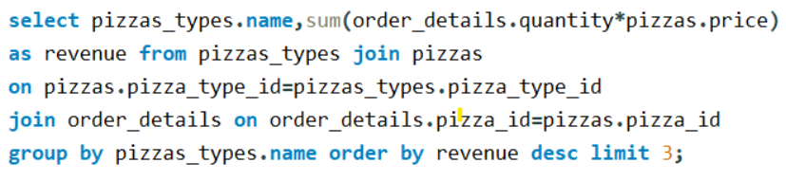

10.Determine the top 3 most ordered pizza types based on
revenue.

Slide 13
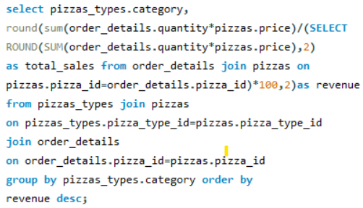
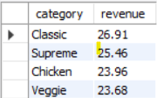
11.Calculate the percentage contribution of each pizza type
to total
revenue.

Slide 14
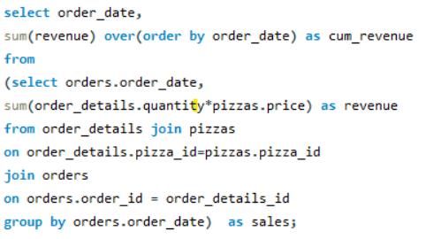
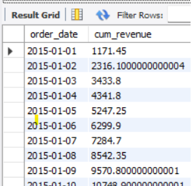
12.Analyze the cumulative revenue generated over time.
Large data…..

Slide 15
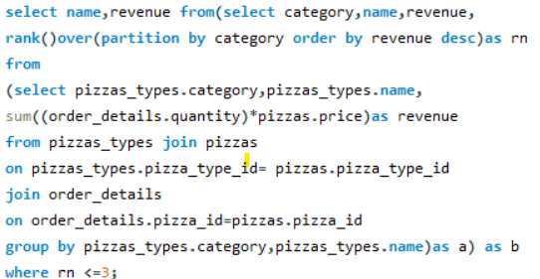
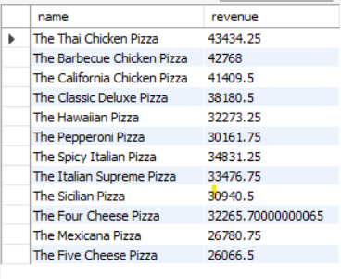
13.Determine the top 3 most ordered pizza types based on
Revenue for each pizza category.

Slide 16
THE END
THANK YOU

